Slide 1
SENTIMENT ANALYSIS: TEXT MINING USING LAMBDA ARCHITECTURE

Slide 2
SENTIMENT ANALYSIS IMPORTANCE:
Sentiment Analysis is the key of “SUCCESS” for manufacturers.
Sentient Analysis fetches customer’s emotion, attitude towards the product.
Once valuable information collected, manufacturers can
“dig deep into issue”
GOAL: Improve quality of product

Slide 3
EXTRACTING STRONGEST POSITIVE, NEGATIVE AND NEUTRAL
POSITIVE:
Good watch at reasonable price
NEGATIVE:
Within 2 week the watch is running slow after 1 month running with 45minutes slow changed the battery then it is working smoothly but after 3 month the brown color coating is going lost my money
NEUTRAL:
Watch is fine.

Slide 4


SCRAPY
WEB SRAPPING: COLLECTING DATA FROM WEBSITE. (AMAZON.IN)
ANALYZE HTML STRUCTURE TO SCRAP DATA.
NEXT IMAGE:
Scraping is legal ? Data extracted should be of fair use
(https://blog.datahut.co/is-web-data-scraping-legal/)

Slide 5
LOADING AND CLEANING DATA
Scraped data are loaded into pandas dataframe.
Empty values are dropped.
Improves the Efficiency of analyzing customer reviews.
Improves Decision Making Process.

Slide 6
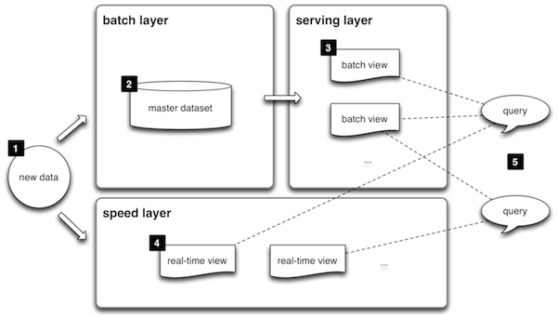
LAMBDA ARCHITECTURE:
Advantages:
Processing large amounts of data at high velocity.
Scalability and quick response time
Fault tolerant
reliability

Slide 7
K-Nearest Neighbors Algorithm
ADVANTAGES:
SIMPLE, EASY TO IMPLEMENT.
NO NEED TO BUILD MODEL.
VERSATILE(CLASSIFICATION, REGRESSION)
FACTS:
SUPERVISED ALGORITHM
CLASSIFICATION, REGRESSION
TAKES LABELLED DATA AND PROCESSES UNLABELLED DATA
CLASSIFICATION RETURNS DISCRETE VALUES(MODE)
REGRESSION RETURNS REAL NUMBERS(MEAN)

Slide 8
SUPPORT VECTOR MACHINE
ADVANTAGES:
FOR TEXT CLASSFICATION
OVERFITTING IS LESS
WORKS GOOD ON UNSTRUCTURED DATA
SUPERVISED LEARNING:
HYPERPLANE SEPERATES INTO CLASSES
TAKES LABELLED DATA TO ITS FUNCTION
POINTS CLOSEST TO THE LINE ARE SUPPORT VECTORS
DIFFERENCE BETWEEN LINE AND SUPPORT VECTOR ARE MAXIMIZE MARGINS
WE CAN PROCESS NON-LINEAR BY HIGHER DIMENSION(ADDING MORE DIMENSIONS)

Slide 9
NAIVE BAYES ALGORITHM
DISADVANTAGES:
If categorical variable has a category (in test data set), which was not observed in training data set, then model will assign a 0 (zero)
On the other side naive Bayes is also known as a bad estimator, so the probability outputs are not to be taken too seriously.
In real life, it is almost impossible that we get a set of predictors which are completely independent.
ADVANTAGES:
FINDING BASE ACCURACY
FACTS:
PROBABILISTIC MACHINE LEARNING ALGORITHM
P(Y/X)=(P(X/Y)*P(Y))/P(X)

Slide 10
VISUALIZATION:
Interact With Data
identify emerging trends and act quickly based on what we see
analysis at various levels of detail
Displayed bar chart(rating stars overall)
Displayed pie chart(positive, negative and neutral)
Wordcloud(displaying strong words)
Etc.

Slide 11
THANK YOU FOR THE OPPURTUNITY

